Slide 1

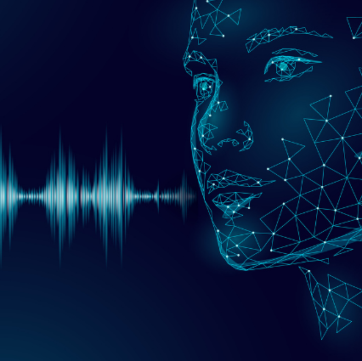
Voice Biometrics - SBI
-Team Fuji

Slide 2
PROBLEM BEING SOLVED
Customers interact with the Bank via various channels such as Contact Centre & Video based Customer Identification Process Calls. Authentication measures of Caller ID / PIN / Security Questions / Device Signatures are often inadequate and intrusive.

Slide 3
Approach Taken to Create The Model:
2 level voice authentication:
1 security question for voice authentication
3 pass-phrases/words will be generated in real-time for user authentication
Use speech-to-text API:
Used to transcribe voice into text
Use of Speaker Recognition API:
Verifies unique voice characteristics for an individual
Speaker Identification and Verification:
Use voice to verify speakers and Identify individual speakers within a group
(classification approach)

Slide 4
Prerequisites
Audio samples collected from contact center, mobile app and KYC
For training
Minimum audio input length per request is 1 second
Maximum audio input length per request is 120 seconds
Minimum total effective speech length (excluding silence and other non-speech frames) for creating a voiceprint is 20 seconds This limitation can be disabled by setting ignoreMinLength to true.
Maximum total audio input length allowed for creating a voiceprint is 300 seconds
Minimum audio Signal-to-noise ratio (SNR) is 2dB

Slide 5
Prerequisites
For recognizing
Minimum audio input length is 1 second
Maximum audio input length is 120 seconds
Minimum candidate speakers count is 1
Maximum candidate speakers count is 50
Minimum effective speech length (excluding silence and other non-speech frames) is 4 seconds This limitation can be disabled by setting "ignoreMinLength" to true.
Minimum audio Signal-to-noise ratio (SNR) is 2dB

Slide 6
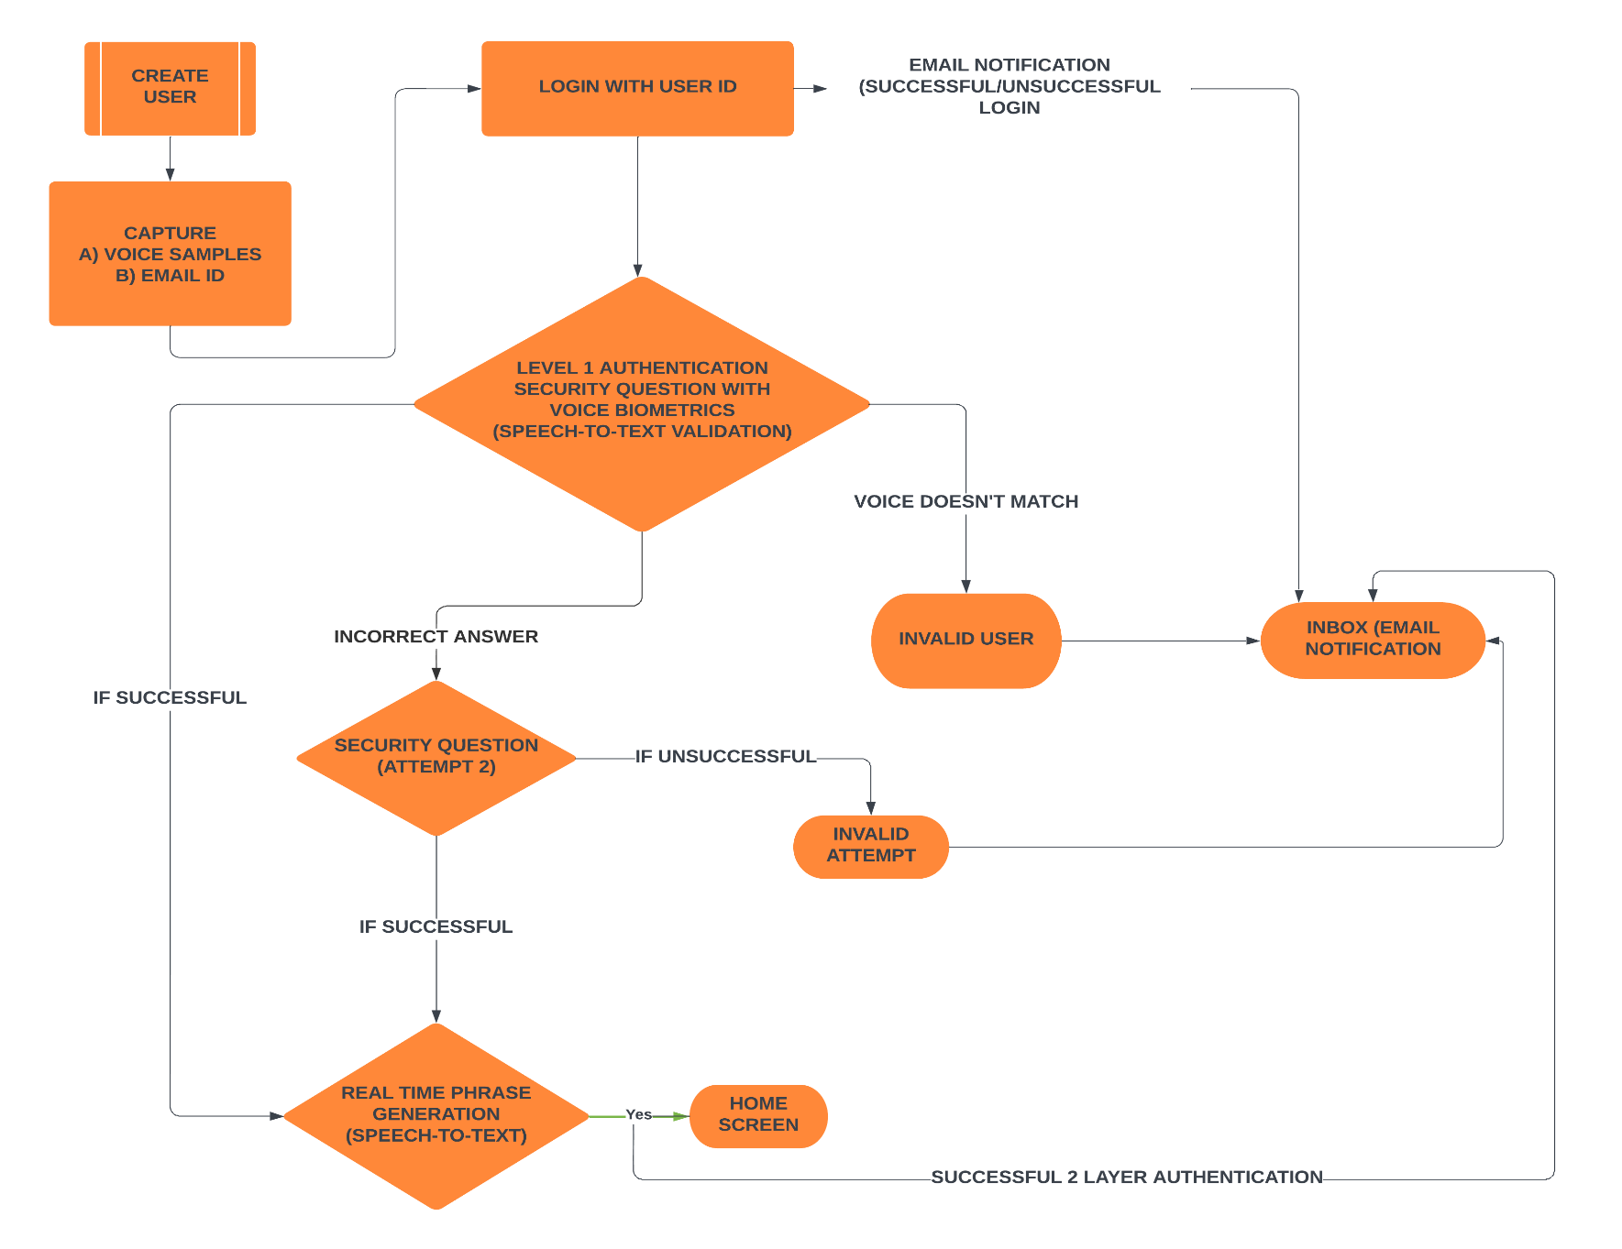
FUNCTIONAL ARCHITECTURE

Slide 7
Non-Functional Requirements(NFR)
Data Privacy
Security
Reliability
Portability
Scalability
Disaster Recovery
Mobility
Fast and Frictionless Authentication

Slide 8
Reason Why your solution should be considered
We are providing Voice recognition for multiple users
2 level authentication
Real time phrase generation
Multi-language support
Multi-region support
Security check
Notification facility
Reduce threats from fraudsters, phishing etc.
Reduction in Customer service executive’s time and effort

Slide 9
Presented By: Team Fuji
Team Member | E-Mail ID | Phone Number
Akshaya Prakash | akshayap@hexaware.com | +91-9567179957
Shreya Mishra | shreyam@hexaware.com | +91-9556453211
Sharmilan K | sharmilank@hexaware.com | +91-7695821302
B Ruba Vignesh | brubav@hexaware.com | +91-9789905844

Slide 10

Thank you

